Slide 1
Improving Data Reuse in NPU On-chip Memory with Interleaved Gradient Order for DNN Training
Jungwoo Kim, Seonjin Na, Sanghyeon Lee, Sunho Lee, and Jaehyuk Huh
56th IEEE/ACM International Symposium on Microarchitecture (MICRO)

Slide 2
DNN Training Problem : Backward Pass!
Computation of gradients in the backward pass accounts for majority of costs in model training.
Backward pass has to compute input gradient & weight gradient both from output graident.
This incurs off-chip memory accesses, the most time consuming part in training.

Slide 3
Prior Work
Prior works focus on intra-operation data reuse.
This cannot represent multiple independent operations, it can only represent single nested loop.
Thus, they lose chance of performance improvement opportunity by data reuse.

Slide 4
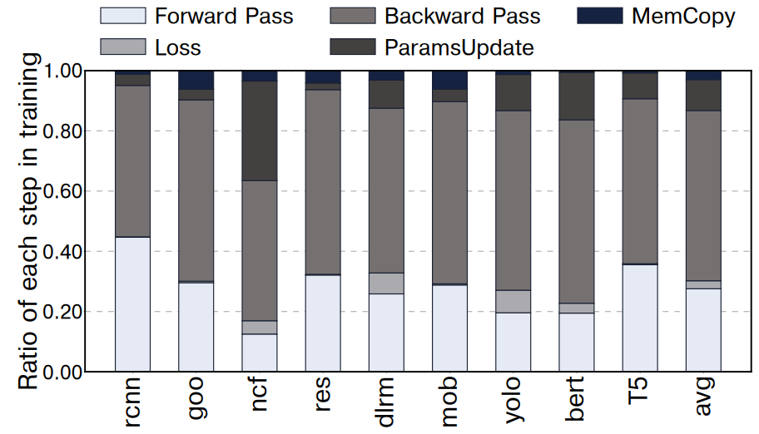
Motivation : DNN Training Ratio
-> Backward pass occupies most of time on training process, indeed.

Slide 5
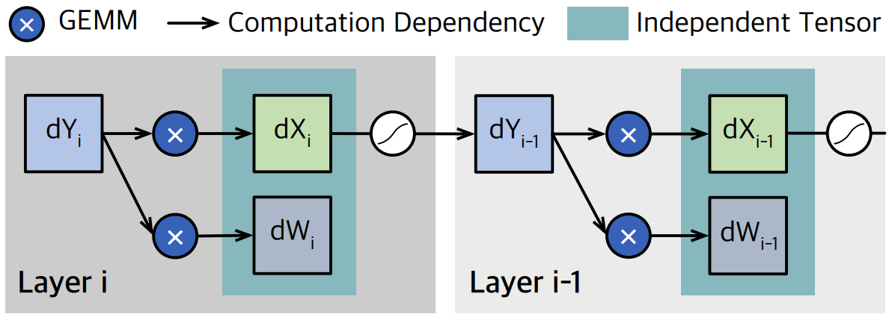
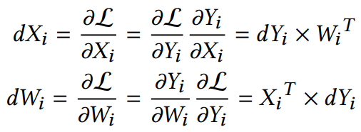
Motivation : Redundant Access
In the figure above, dXi and dWi are computed by using the same dYi as an operand.
As these are independent, it is possible to reorder or even fuse two operations in an interleaved manner.
Additionally, redundant accesses to the output gradient (dYi) can be potentially reduced by such fusion.

Slide 6
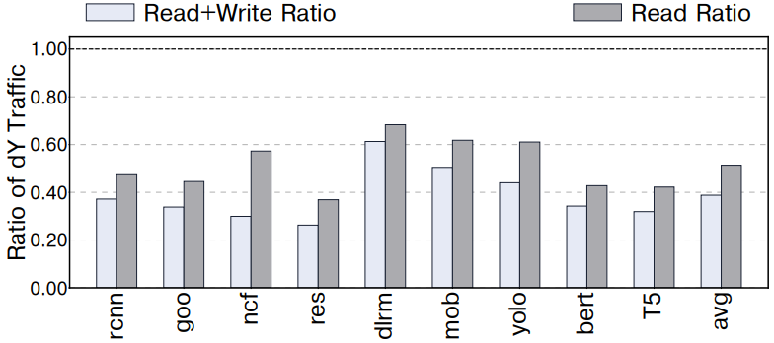
Motivation : Data Traffic of dYi
The ratio of dYi traffic compared to all read and write data, which is 39.0% of total data traffic on average.
Furthermore, dYi occupies 51.4% of read data on average.
This shows opportunities to improve performance by reducing the dYi traffic.

Slide 7
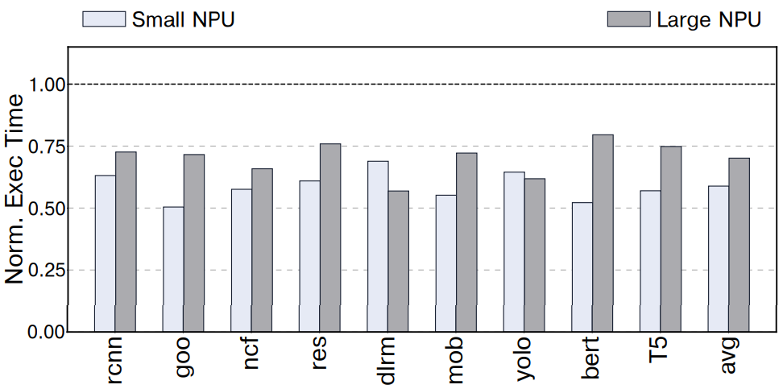
Motivation : Potential Performance
How much is the performance potential of eliminating redundant reads for the output gradient?
Researchers simulated with the elimination one of two accesses for dY.
As a result, the speed up against the baseline is 1.43x in Large NPU and 1.70x in Small NPU.

Slide 8
Data Reuse Opportunity
Off-chip memory access is a problem -> we need on-chip SPM, Scratchpad Memory.
This paper introduces a novel code transformation technique aimed at removing unnecessary memory accesses for the output gradient.
This is called interleaved gradient order, which enables data reuse on SPM.

Slide 9
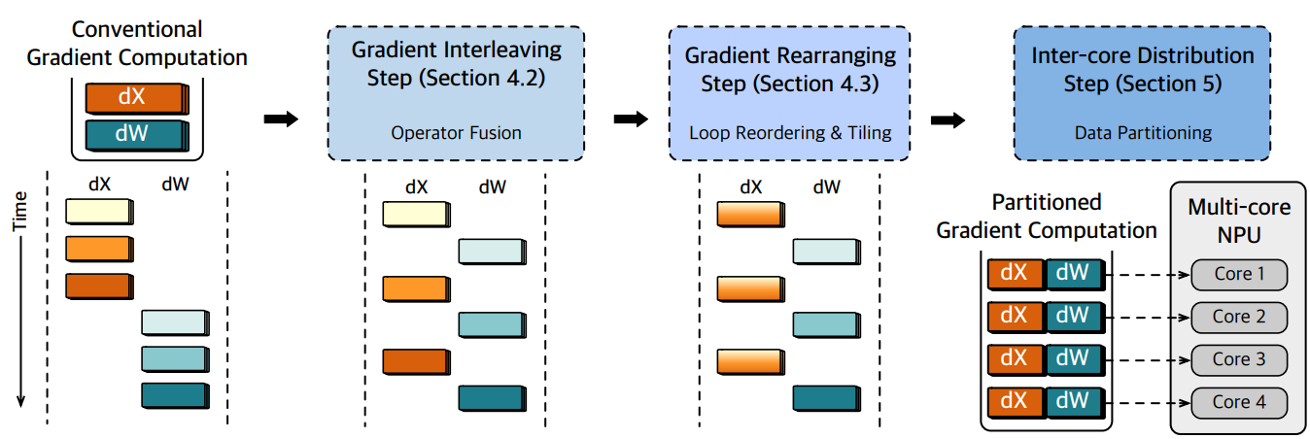
Overview
Gradient Interleaving Step
Gradient Rearranging Step
Inter-core Distribution Step

Slide 10
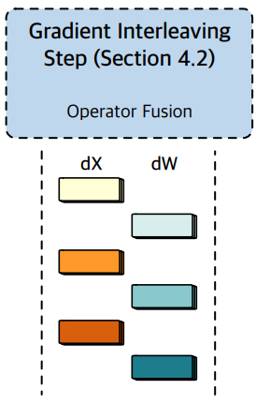
Overview : Gradient Interleaving Step
This step combines two computations for dW and dX.
Interleaves tiled operations for them.

Slide 11
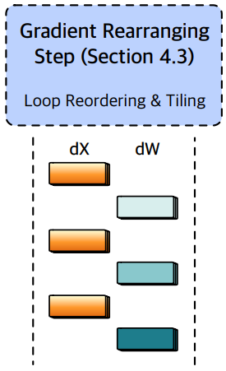
Overview : Gradient Rearranging Step
Effectiveness of tile reuses can vary depending on the operand dimensions.
Thus, gradient rearranging step reorganizes interleaved dX and dW computations.

Slide 12
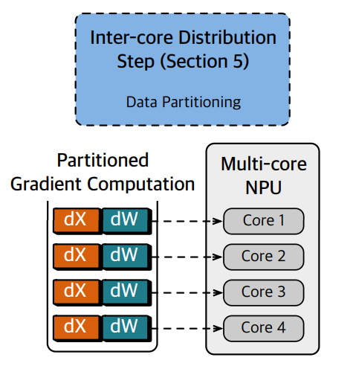
Overview : Inter-core Distribution Step
For multi-core NPUs, operands are decomposed and assigned to different cores to maximize dY reuse.
This step determines the optimal methods for operand decomposition.
Finally, each segment is allocated to an NPU core.

Slide 13

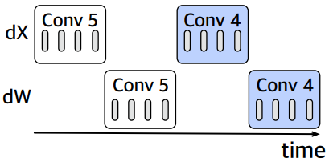
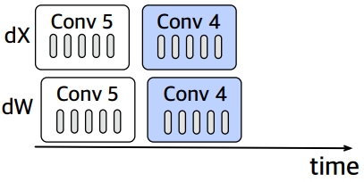
Gradient Interleaving Step
Baseline approach
dX and dW are calculated in a sequential manner.
dY can be transferred to SPM twice due to prior loaded tile being evicted.
Interleaved computation
dX and dW computations are interleaved (no dependency between them).
Transformed code eliminates redundant accesses to dY tiles.

Slide 14
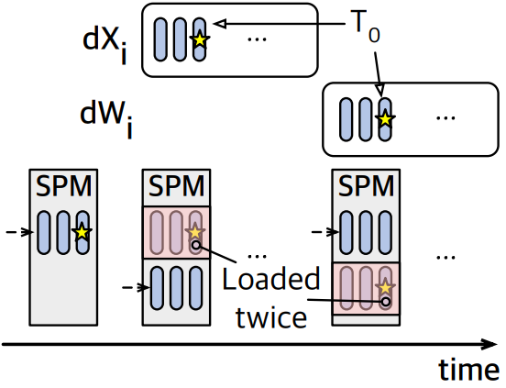
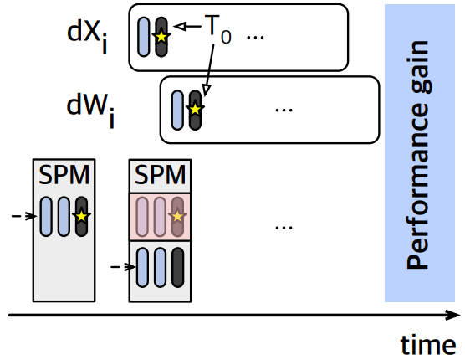
Gradient Interleaving Step
Baseline approach
Yellow starred dYi loaded twice.
Because distance between dXi and dWi calculations exceeds the capacity of SPM.
Interleaved computation
Yellow starred dYi can be reused just one loading when interleaving is applied.
Thus, interleaving significantly reduces data traiffc and boosts the utilization of SPM.

Slide 15
Gradient Interleaving Step : Problems
Interleaving method does not significantly improve performance in certain layers that contain non-square tensors.
Why? The access patterns for dYi differ between dXi and dWi computations.

Slide 16
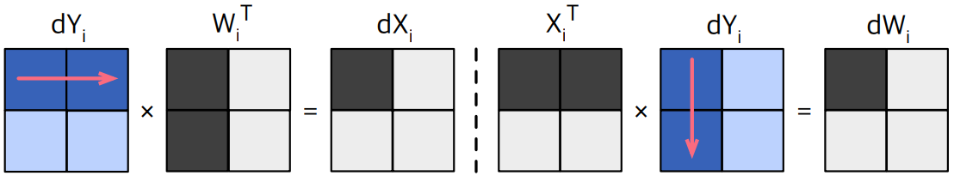
Gradient Interleaving Step : Problems
When computing dXi, the access of dYi follows a row-major access order.
When computing dWi, dYi is accessed in a column-major order.

Slide 17
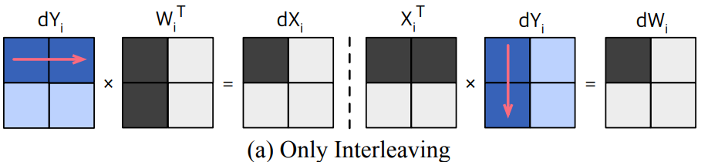
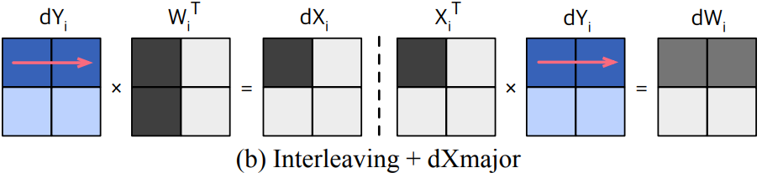
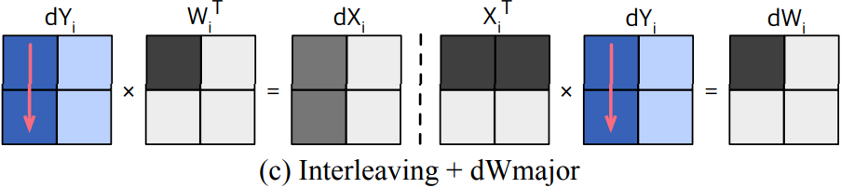
Three Groups of Memory Access Orders
Traditional access order
row-major access for both dXi and dWi
column-major access for both dXi and dWi

Slide 18
Selection Algorithm
+ Data reuse of dYi can be enhanced by appropriately altering the memory access order.
- Intermediate results can be generated in dWmajor and dXmajor due to the changed computation order.
-> Straightforward but fairly accurate algorithm is needed.

Slide 19
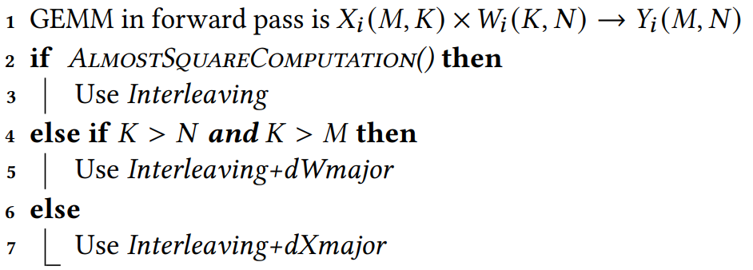
Selection Algorithm
Algorithm selects appropriate memory access order based on the shape of tensors.
Nearly square tensors by AlmostSquareComputation() -> Only Interleaving.
Non-square tensor
Column dim of Wi > Row dim of Wi -> Interleaving + dWmajor
Otherwise -> Interleaving + dXmajor
Notes:
\frac {𝑀𝑎𝑥 (𝑀,𝑁 ,𝐾)}
{𝑀𝑖𝑛(𝑀,𝑁 ,𝐾)}
< 4

Slide 20
Gradient Rearranging Step
Gradient rearranging step is combination of:
Interleaved gradient computations
Selection of optimal tile access order
Notes:
\frac {𝑀𝑎𝑥 (𝑀,𝑁 ,𝐾)}
{𝑀𝑖𝑛(𝑀,𝑁 ,𝐾)}
< 4

Slide 21
Data Partitioning
Single GEMM divided into smaller partitioned GEMMs.
Performance depends on the dimensions of the GEMM.
Thus, we need new data partitioning schemes to better suit interleaving and rearrangement steps.

Slide 22
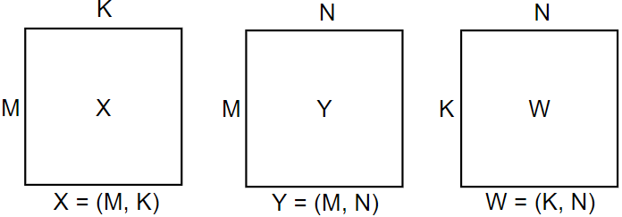
Data Partitioning
Three Tensors:
X
W
Y
It is common for GEMM to be partitioned on a batch basis (dimension M).
dY and X are split for computing dX and dW.
Notes:
그림 추가 및 부가 설명 추가, X^T latex 렌더링

Slide 23
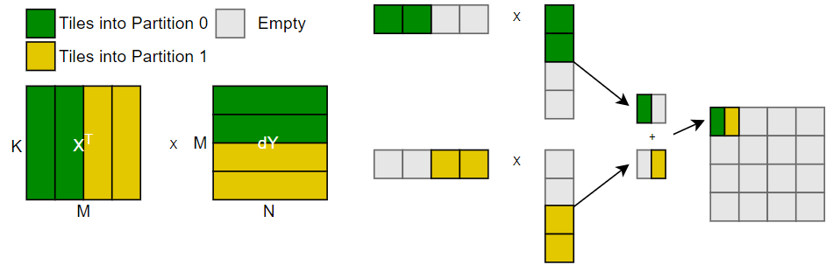
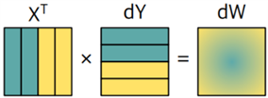
Data Partitioning : Problem
Partitioned on a batch basis has a problem.
- dW: dY being right-hand-side operand
- dX: dY being left-hand-side operand
-> This prevents a single partition from performing all the necessary calculations.
-> Also it might have to accumulate intermediate results from multiple partitions.
-> If M is not significant in GEMM, this is not an efficient way.

Slide 24
Data Partitioning in Another Dimensions
Partitioning GEMM in N or K dimension rather than M dimension could be more efficient in some layers.

Slide 25
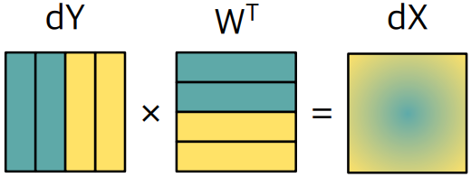
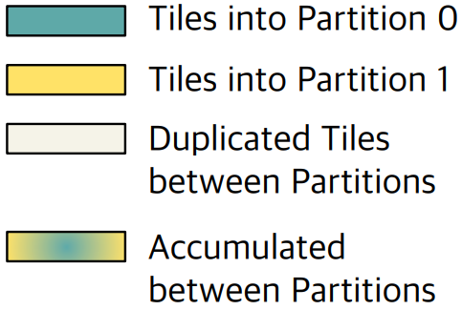
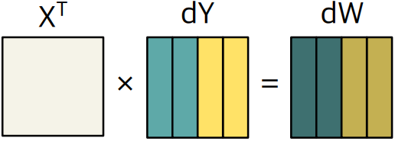
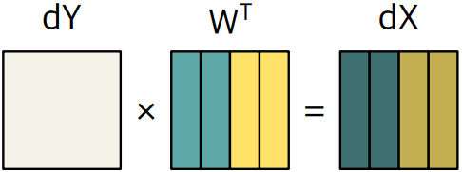
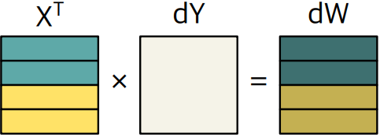
Data Partitioning in Another Dimensions
Partitioning GEMM in N
All X is duplicated.
Requires another accumulation
Partitioning GEMM in K
All dY is duplicated.
Requires no accumulation

Slide 26
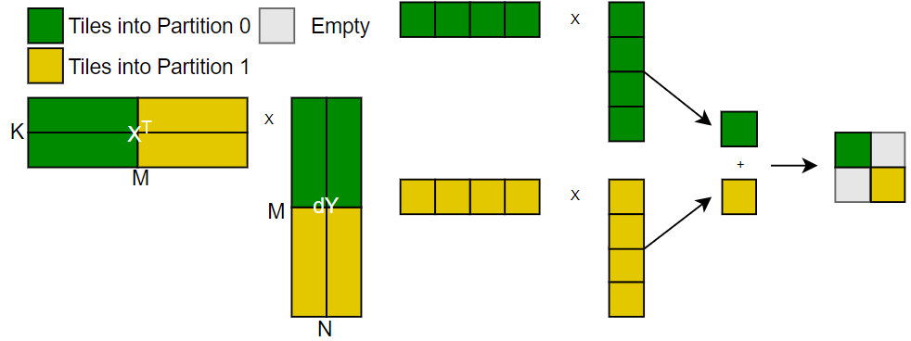
Data Partitioning : Selection
Finally, overall performance depends on the dimensions of tensors.
What if dimension M is siginificant rather than N and K in GEMM?
-> Systolic array can be fully utilized.
-> Because dimension M is wide enough. If it is not, other data partitioning scheme should be considered.

Slide 27
Data Partitioning : Selection
We need to determine optimal data partitioning schemes for each layer.
Thus, KNN algorithm is applied using the dimensions of dX, dW, dY as features.
It has 91% accuracy and wrong predictions are negligible for performance.

Slide 28
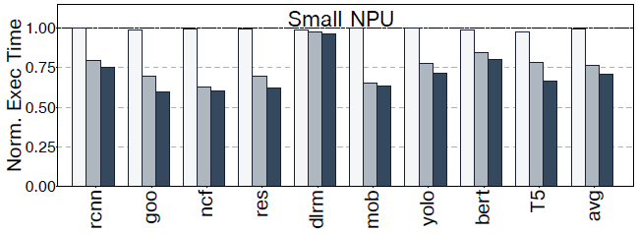
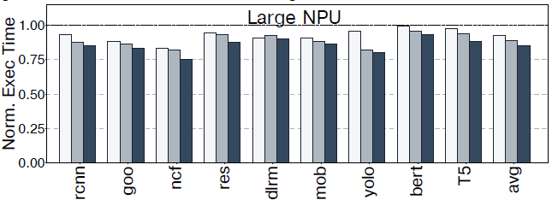
Performance Evaluation
Performance improvement on average
Small NPU: 29.3%
Large NPU : 14.5%

Slide 29
Performance Evaluation
Small NPU has more performance improvement since small NPU has smaller SPM.
Thus, on-chip data reuse by interleaved gradient order becomes more significant.

Slide 30
Summary
Interleaved Gradient Order maximizes data reuse within SPM during the backward pass of DNN training.
Improves performance by inter-operation data sharing, not just intra-operation as prior works.
This has three key steps.
Interleaves gradient computation
Select optimal tile access order
Data partitioning by selection algorithm
Performance improvement of 29.3% for small NPU and 14.5% for large NPU.

